Slide 1
Unit-1
Database System Architecture
Database Management Systems (DBMS)
GTU # 3130703

Slide 2
Basics | File System | DBMS
Structure | The file system is a way of arranging the files in a storage medium within a computer. | DBMS is software for managing the database.
Data Redundancy | Redundant data can be present in a file system. | In DBMS there is no redundant data.
Backup and Recovery | It doesn’t provide backup and recovery of data if it is lost. | It provides backup and recovery of data even if it is lost.
Query processing | There is no efficient query processing in the file system. | Efficient query processing is there in DBMS.
Consistency | There is less data consistency in the file system. | There is more data consistency because of the process of normalization.
Security Constraints | File systems provide less security in comparison to DBMS. | DBMS has more security mechanisms as compared to file systems.
Cost | It is less expensive than DBMS. | It has a comparatively higher cost than a file system.

Slide 3
Basics | File System | DBMS
Data Independence | There is no data independence. | In DBMS data independence exists.
User Access | Only one user can access data at a time. | Multiple users can access data at a time.
Sharing | Data is distributed in many files. So, not easy to share data | Due to centralized nature sharing is easy
Integrity Constraints | Integrity Constraints are difficult to implement | Integrity constraints are easy to implement
Attributes | To access data in a file , user requires attributes such as file name ,file location. | No such attributes are required.
Example | Cobol, C++ | Oracle, SQL Server

Slide 4

Looping
Outline
  Introduction of DBMS
  Applications of DBMS
  Advantages of DBMS
  Three levels ANSI SPARC database system
  Data Abstraction in DBMS
  Mappings and data independence
  Database users and DBA
  Database system architecture

Slide 5


Slide 6
What is Database Management System (DBMS)?
Data - Fact that can be recorded or stored
  e.g. Person Name, Age, Gender and Weight etc.
Database - Collection of logically related data
  e.g. Books Database in Library, Student Database in University etc.
Management - Manipulation, Searching and Security of data
  e.g. Viewing result in GTU website, Searching exam papers in GTU website etc.
System - Programs or tools used to manage database
  e.g. SQL Server Studio Express, Oracle etc.
DBMS - A Database Management System is a software for creating and managing databases.
Database Management System (DBMS) is a software designed to define, manipulate, retrieve and manage data in a database.
  e.g. MS SQL Server, Oracle, My SQL, SQLite, MongoDB etc.

Slide 7


Slide 8
Applications of DBMS
DBMS is a computerized record-keeping system.
DBMS is required where ever data need to be stored.
  E-Commerce (Flikart, Amazon, Shopclues, eBay etc...)
  Online Television Streaming (Hotstar, Amazon Prime etc...)
  Social Media (WhatsApp, Facebook, Twitter, LinkedIn etc...)
  Banking & Insurance
  Airline & Railway
  Universities and Colleges/Schools
  Library Management System
  Human Resource Department
  Hospitals and Medical Stores
  Government Organizations
Exercise
Write down any five applications of DBMS other than above.

Slide 9


Slide 10

Reduce data redundancy (duplication)
Computer
Civil
Emp_Name | Address | Mobile | Subject
Emp_Name | Address | Mobile | Subject
Prof. Ajay Shah | Rajkot | 1234 | PPS
Prof. Ajay Shah | Rajkot | 1234 | PPS
  Database management system can remove such data redundancy by storing data centrally.
  Same data is stored at
  four different places.
Emp_Name | Address | Mobile | Subject
Emp_Name | Address | Mobile | Subject
Prof. Ajay Shah | Rajkot | 1234 | PPS
Prof. Ajay Shah | Rajkot | 1234 | PPS
Electrical
Mechanical

Slide 11
Remove data inconsistency
Computer
Civil
Emp_Name | Address | Mobile | Subject
Emp_Name | Address | Mobile | Subject
6789
Prof. Ajay Shah | Rajkot | 1234 | PPS
Prof. Ajay Shah | Rajkot | 1234 | PPS
  Database management system can keep data in consistent state.
  Same data having
  different state (values)
  Mobile no is changed
Emp_Name | Address | Mobile | Subject
Emp_Name | Address | Mobile | Subject
6789
Prof. Ajay Shah | Rajkot | 1234 | PPS
Prof. Ajay Shah | Rajkot | 1234 | PPS
Electrical
Mechanical

Slide 12


Guaranteed atomicity
Atomicity: Either transaction execute 0% or 100%.
Sum of both account before transfer is 3000
Person A
Account A
Bal : 2000
Transfer 500
Person B
Account B
Bal : 1000
Step 1 : Debit 500 from Account A
Step 2 : Credit 500 into Account B
Transaction is failed
Sum of both account is 2500
so inconsistent
Sum of both account
after transfer is 3000

Slide 13
Data isolation
Data are scattered in various files.
Files may be in different formats.
Difficult to retrieve the appropriate data.
File - 1
Emp_Name | Address | Mobile | Subject
Prof. Ajay Shah | Rajkot | 1234 | PPS
DBMS allow us to access (retrieve) appropriate data easily.
File - 2
Emp_Name | Post | Salary | Load
Prof. Ajay Shah | Lecturer | 50,000 | 15
Data isolation is a property that determines when and how changes made by one operation become visible to other concurrent users and systems.
This issue occurs in a concurrency situation.
File - 3
Emp_Name | Teaching | Knowledge | Rating
Prof. Ajay Shah | Good | Excellent | 9

Slide 14
Allow to implement integrity constraints
Emp_Name | Address | Mobile_No | Subject
Prof. Ajay Shah | Rajkot | 9876543210 | PPS
Should contain exact 10 digits
Student_Name | Branch | Backlog | SPI
Nirav Patel | Rajkot | 0 | 8.5
Should be between 0 to 10
DBMS allows us to implement such business rules in our database..

Slide 15

Sharing of data among multiple users
Want to access
Computer
Civil
Emp_Name | Address | Mobile | Subject
Emp_Name | Address | Mobile | Subject
Prof. Ajay Shah | Rajkot | 1234 | PPS
Prof. Ajay Shah | Rajkot | 1234 | PPS
Want to access
  Database management system allows more than one user to access same data simultaneously.
Emp_Name | Address | Mobile | Subject
Emp_Name | Address | Mobile | Subject
Prof. Ajay Shah | Rajkot | 1234 | PPS
Prof. Ajay Shah | Rajkot | 1234 | PPS
Electrical
Mechanical

Slide 16

Restricting unauthorized access to data
File - 1
Emp_Name | Address | Mobile | Subject
Prof. Ajay Shah | Rajkot | 1234 | PPS
Wants to access
Faculty of other college
File - 2
Emp_Name | Post | Salary | Load
Prof. Ajay Shah | Lecturer | 50,000 | 15
Wants to access
ITMBU Faculty
File - 3
Emp_Name | Teaching | Knowledge | Rating
Prof. Ajay Shah | Good | Excellent | 9
DBMS prevents unauthorized user to access data.

Slide 17
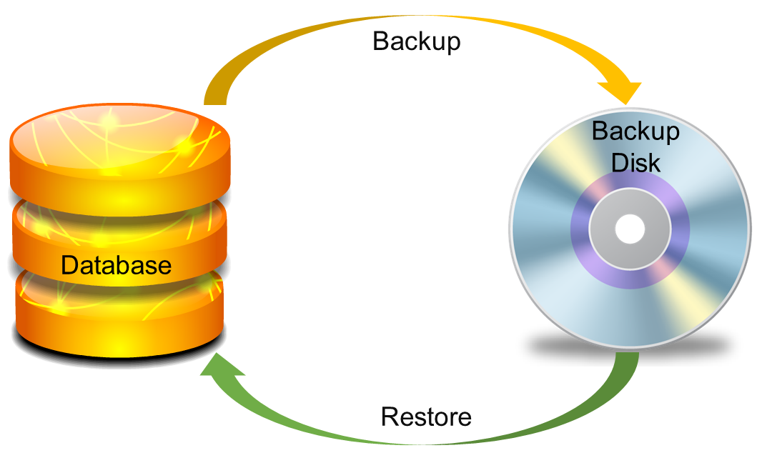
Providing backup and recovery services
Provides facilities to backup and restore the database in case of failure.

Slide 18
Advantages of DBMS (Summary)
Reduce data redundancy (duplication)
  Avoids unnecessary duplication of data by storing data centrally.
Remove data inconsistency
  By eliminating redundancy, data inconsistency can be removed.
Data isolation
  A user can easily retrieve proper data as per his/her requirement.
Guaranteed atomicity
  Either transaction executes 0% or 100%.

Slide 19
Advantages of DBMS (Summary)
Allow implementing integrity constraints
  Business rules can be implemented such as do not allow to store amount less than Rs. 0 in balance.
Sharing of data among multiple users
  More than one users can access same data at the same time.
Restricting unauthorized access to data
  A user can only access data which is authorized to him/her.
Providing backup and recovery services
  Can take a regular auto or manual backup and use it to restore the database if it corrupts.

Slide 20


Slide 21
Basic terms
Data
  Data is raw, unorganized facts that need to be processed.
  Example: Marks of students
  Student_1 = 50/100, Student_2 = 25/100.
Information
  When data is processed, organized, structured or presented in a given context so as to make it useful, it is called information.
  Example: Result of students (Pass or Fail)
  Student_1 = Pass, Student_2 = Fail.

Slide 22
Basic terms (cont…)
Metadata
  Metadata is data about data.
  Data such as table name, column name, data type, authorized user and user access privileges for any table is called metadata for that table.
  Metadata of above table is:
    Table name such as Faculty
    Column name such as Emp_Name, Address, Mobile_No, Subject
    Datatype such as Varchar, Decimal
    Access privileges such as Read, Write (Update)
Faculty
Emp_Name | Address | Mobile_No | Subject
Prof. Ajay Shah | Rajkot | 9876543210 | PPS

Slide 23
Basic terms (cont…)
Data dictionary
  A data dictionary is an information repository which contains metadata.
Data warehouse
  A data warehouse is an information repository which stores data.
  Table Name – Faculty
  Column Name – EmpName, Address, Mob, Subject, Salary
  Datatype – Varchar, Decimal
  Access Privileges – Read, Write (Update)
Faculty
Emp_Name | Address | Mobile_No | Subject
Prof. Ajay Shah | Rajkot | 9876543210 | PPS
Prof. Ajay Patel | Surat | 0123456789 | DBMS
Exercise
Why data dictionary and data warehouse are stored in the different places?

Slide 24
Basic terms (cont…)
Field
  A field is a character or group of characters that have a specific meaning.
  E.g, the value of Emp_Name, Address, Mobile_No etc are all fields of Faculty table.
Record / Tuple
  A record is a collection of logically related fields.
  E.g, the collection of fields (Emp_Name, Address, Mobile_No, Subject) forms a record for the Faculty.
Faculty
Emp_Name | Address | Mobile_No | Subject
Prof. Ajay Shah | Rajkot | 9876543210 | PPS
Prof. Ajay Patel | Surat | 0123456789 | DBMS
Fields
Prof. Ajay Shah
Rajkot
9876543210
Prof. Ajay Shah | Rajkot | 9876543210 | PPS
Record / Tuple
Prof. Ajay Patel | Surat | 0123456789 | DBMS

Slide 25
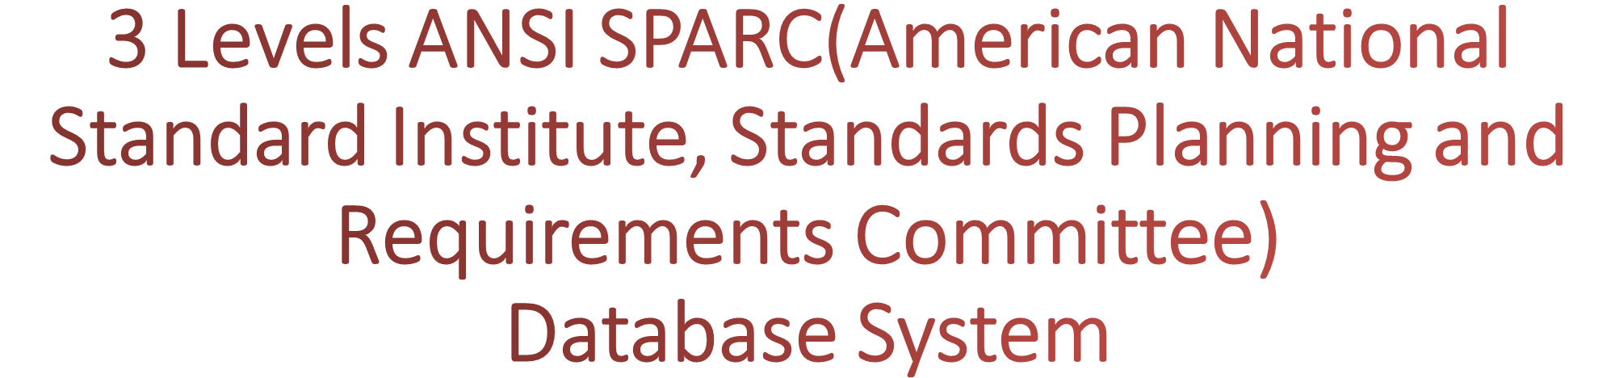

Slide 26

3 Levels ANSI SPARC Database System
User 1
User 2
User 3
How data are viewed by each users?
View 1
View 2
View 3
View
Level
What data are stored and
What relationships exist?
Conceptual
Level
Logical
Level
How the data are actually stored on storage devices?
Internal
Level
Physical
Level
Database

Slide 27
3 Levels ANSI SPARC Database System
Internal level (Physical level)
  It describes how a data is stored on the storage device.
  Deals with physical storage of data.
    Structure of records on disk - files, pages, blocks and indexes and ordering of records
  Internal view is described by the internal schema.
Conceptual level (Logical level)
  What data are stored and what relationships exist among those data?
  It hides low level complexities of physical storage.
  For Example, STUDENT database may contain STUDENT and COURSE tables which will be visible to users but users are unaware about their storage.
  Database administrator works at this level to determine what data to keep in the database.

Slide 28
3 Levels ANSI SPARC Database System
External level (View level)
  It describes only part of the entire database that an end user concern or how data are viewed by each user.
  Different user needs different views of the database, so there can be many views in a view level abstraction of the database. Used by end users and application programmers.
  End users need to access only part of the database rather than the entire database.

Slide 29
3 Levels ANSI SPARC Database System: Example
We are storing student information in a student table.
User 1
User 2
User 3
User just interact with system with the help of GUI.
Users are not aware of how and what the data is stored.
View 1
View 2
View 3
View
Level
Records can be described as fields and attributes along with their data types, their relationship among each other can be logically implemented.
Programmers generally work at this level.
Conceptual
Level
Logical
Level
Records can be described as blocks of storage (bytes, gigabytes, terabytes etc.) in memory.
These details are often hidden from the programmers.
Internal
Level
Physical
Level
Database

Slide 30
Data Abstraction in DBMS
Database systems are made-up of complex data structures.
To ease the user interaction with database, the developers hide internal irrelevant details from users.
This process of hiding irrelevant details from user is called data abstraction.

Slide 31

Mapping and Data Independence
Want to access some data
User 1
User 2
User 3
View 1
View 2
View 3
View
Level
Process of transforming requests and results between the three levels is called mapping.
Conceptual
Level
Logical
Level
Ability to modify a schema definition in one level without affecting a schema definition in the next higher level.
Internal
Level
Physical
Level
Result
Database

Slide 32
Types of Data Independence
Physical Data Independence
  Physical Data Independence is the ability to modify the physical schema without requiring any change in logical (conceptual) schema and application programs.
  Modifications at the internal levels are occasionally necessary to improve performance.
  Possible modifications at internal levels are changes in file structures, compression techniques, hashing algorithms, storage devices, etc.

Slide 33
Types of Data Independence
Logical Data Independence
  Logical data independence is the ability to modify the conceptual schema without requiring any change in application programs.
  Modification at the logical levels is necessary whenever the logical structure of the database is changed.
  Application programs are heavily dependent on logical structures of the data they access. So any change in logical structure also requires programs to change.

Slide 34


Slide 35
Types of Database Users
Naive Users (End Users)
  Unsophisticated users who have zero knowledge of database system
  End user interacts to database via sophisticated software or tools
  e.g. Clerk in bank
Application Programmers
  Programmers who write software using tools such as Java, .Net, PHP etc…
  e.g. Software developers
Sophisticated Users
  Interact with database system without using an application program
  Use query tools like SQL
  e.g. Analyst
Specialized Users (DBA)
  User write specialized database applications program
  Use administration tools
  e.g. Database Administrator

Slide 36


Slide 37
Role of DBA
Schema Definition
  DBA defines the logical schema of the database.
Storage Structure and Access Method Definition
  DBA decides how the data is to be represented in the database & how to access it.
Defining Security and Integrity Constraints
  DBA decides on various security and integrity constraints.
Granting of Authorization for Data Access
  DBA determines which user needs access to which part of the database.
Liaison(group) with Users
  DBA provide necessary data to the user.

Slide 38
Role of DBA
Assisting Application Programmer
  DBA provides assistance to application programmers to develop application programs.
Monitoring Performance
  DBA ensures that better performance is maintained by making a change in the physical or logical schema if required.
Backup and Recovery
  DBA backing up the database on some storage devices such as DVD, CD or magnetic tape or remote servers and recover the system in case of failures, such as flood or virus attack from this backup.

Slide 39
Structured Query Language(SQL)
Structured Query Language(SQL) is the database language by the use of which we can perform certain operations on the existing database and also we can use this language to create a database. SQL uses certain commands like Create, Drop, Insert etc. to carry out the required tasks.
These SQL commands are mainly categorized into four categories as:
DDL – Data Deﬁnition Language
DQl – Data Query Language
DML – Data Manipulation Language
DCL – Data Control Language

Slide 40
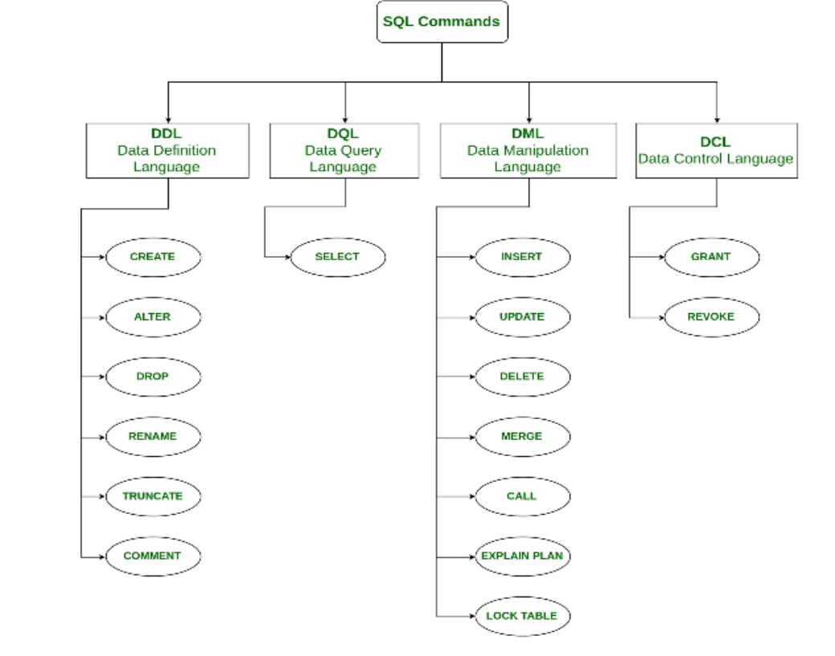

Slide 41
DDL(Data Definition Language)
DDL or Data Definition Language actually consists of the SQL commands that can be used to define the database schema. It simply deals with descriptions of the database schema and is used to create and modify the structure of database objects in the database.
Examples of DDL commands:
CREATE – is used to create the database or its objects (like table, index, function, views, store procedure and triggers).
DROP – is used to delete objects from the database.
ALTER-is used to alter the structure of the database.
TRUNCATE–is used to remove all records from a table, including all spaces allocated for the records are removed.
COMMENT –is used to add comments to the data dictionary.
RENAME –is used to rename an object existing in the database.

Slide 42
DDL(Data Definition Language)
1. CREATE Syntax:
CREATE TABLE TABLE_NAME (COLUMN_NAME DATATYP ES[,....]);
Example: CREATE TABLE EMPLOYEE(Name VARCHAR2(20), Email VARCHAR2(100), DOB DATE);
2. DROP
It is used to delete both the structure and record stored in the table.
Syntax: DROP TABLE ;
Example
DROP TABLE EMPLOYEE;

Slide 43
DDL(Data Definition Language)
3. ALTER
It is used to alter the structure of the database. This change could be either to modify the characteristics of an existing attribute or probably to add a new attribute.
Syntax: To add a new column in the table
ALTER TABLE table_name ADD column_name COLUMNdefinition;
To modify existing column in the table
ALTER TABLE MODIFY(COLUMN DEFINITION....);
EXAMPLE:
ALTER TABLE STU_DETAILS ADD(ADDRESS VARCHAR2(20));
ALTER TABLE STU_DETAILS MODIFY(column NAME VARCHAR2(20));

Slide 44
DDL(Data Definition Language)
4. TRUNCATE
It is used to delete all the rows from the table and free the space containing the table.
Syntax: TRUNCATE TABLE table_name;
Example: TRUNCATE TABLE EMPLOYEE;

Slide 45
DQL (Data Query Language)
DML statements are used for performing queries on the data within schema objects.
The purpose of DQL Command is to get some schema relation based on the query passed to it.
Example of DQL:
SELECT– is used to retrieve data from the a database.
Syntax:
SELECT expressions FROM TABLES WHERE conditions;
Example: SELECT emp_name FROM employee WHERE age > 20;

Slide 46
DML(Data Manipulation Language)
• The SQL commands that deals with the manipulation of data present in the database belong to DML or Data Manipulation Language and this includes most of the SQL statements.
Examples of DML:
INSERT – is used to insert data into a table.
UPDATE – is used to update existing data within a table.
DELETE– is used to delete records from a database table.

Slide 47
DML(Data Manipulation Language)
INSERT Syntax:
INSERT INTO TABLE_NAME (col1, col2, col3,.... col N) VALUES (value1, value2, value3, .... valueN);
Or
INSERT INTO TABLE_NAME VALUES (value1, value2, value3, .... valueN);
For example:
INSERT INTO student(Name, Subject) VALUES (“ABC" , "DBMS");

Slide 48
DML(Data Manipulation Language)
UPDATE: This command is used to update or modify the value of a column in the table.
Syntax:
UPDATE table_name SET [column_name1= value1,...column_nameN = valueN] [WHERE CONDITION] ;
For example:
UPDATE students SET User_Name = ‘abc' WHERE Student_Id = '3’ ;

Slide 49
DML(Data Manipulation Language)
DELETE
It is used to remove one or more row from a table.
Syntax:
DELETE FROM table_name [WHERE condition];
For example:
DELETE FROM student WHERE Name= “ABC";

Slide 50
DCL(Data Control Language)
DCL includes commands such as GRANT and REVOKE which mainly deals with the rights, permissions and other controls of the database system.
Examples of DCL commands:
GRANT-gives user’s access privileges to database.
REVOKE-withdraw user’s access privileges given by using the GRANT command.

Slide 51
TCL(transaction Control Language)
TCL commands deals with the transaction within the database.
Examples of TCL commands:
COMMIT– commits a Transaction.
ROLLBACK– rollbacks a transaction in case of any error occurs.
SAVEPOINT–sets a save point within a transaction.
SET TRANSACTION–specify characteristics for the transaction.

Slide 52
Questions asked
List and explain the advantages of DBMS over file based system. OR Explain disadvantages of files based system.
Draw and explain 3 level architecture of DBMS.
List and explain different categories/types of database users.
List and explain different tasks/roles/functions/duties of DBA (Database Administrator).
Explain DBMS architecture with block diagram. OR Explain Database System architecture with block diagram.

